Slide 1


Slide 2

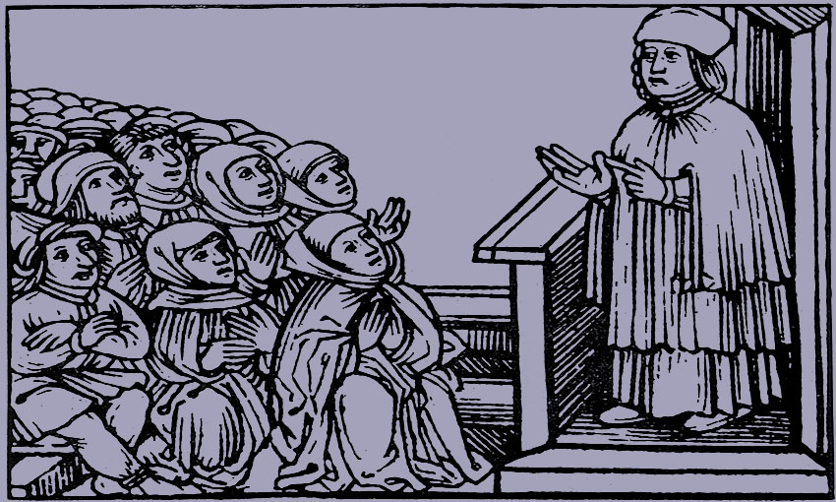
The Bohemian Reformation
Czech reformer Jan Hus, burned at the stake
in 1415 in Constance
Daily communion with bread and wine
for clergy and lay people, including infants
After the perion of Hussite wars in 1457
the Unity of the Brethen was formed
Bible of Kralice – translation, which
significantly influenced Czech culture
The end of the Czech Reformation – battle
of White Mountain in 1620

Slide 3
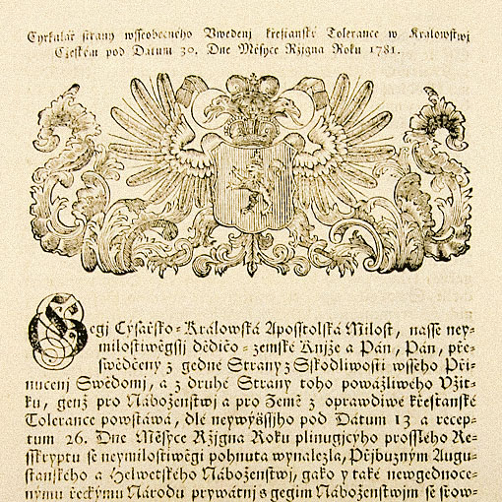
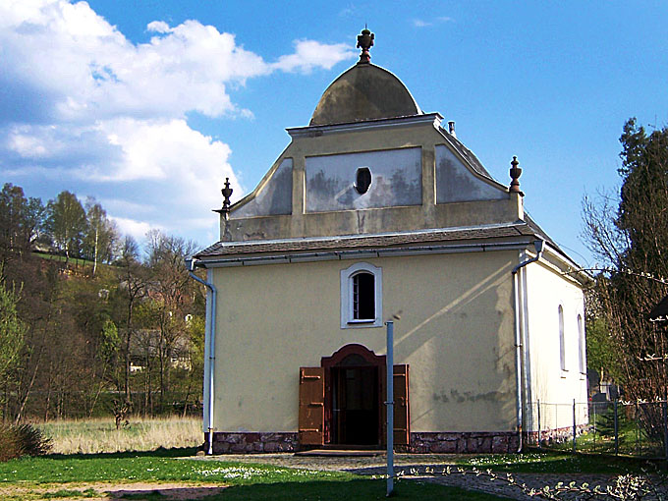
Patent of Toleration
The Patent of Toleration was issued
in 1781 by Joseph II
Only three non-Catholic denominations
were allowed: Augsburg, Helvetic
and Orthodox
In the first years after the proclamation
of the Patent 78,000 people adhered
to Protestantism
Up until 1861 Protestants were still limited
by numerous restrictions

Slide 4
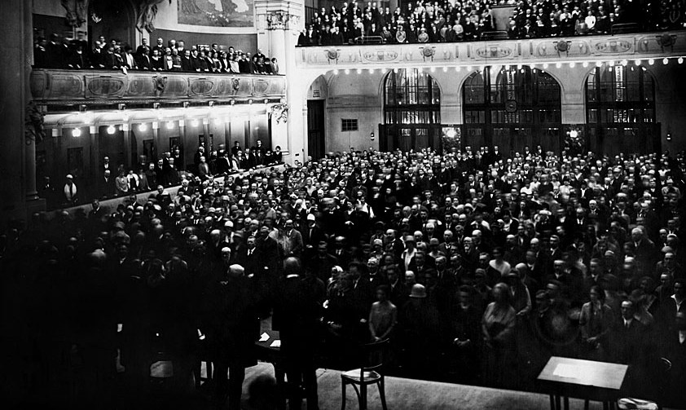
Foundation of the Evangelical
Church of Czech Brethen
The ECCB was formed in 1918
by unification of two autonomous
protestant wings – Lutheran and Reformed
German speaking Protestants formed their
own German Protestant Church in 1919
In 1919 the Hus Theological Faculty
was established
In the beginning the ECCB had
250,000 members, steadily growing
to 325,000 in 1938

Slide 5
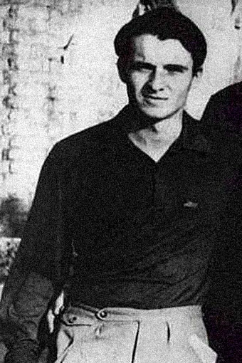
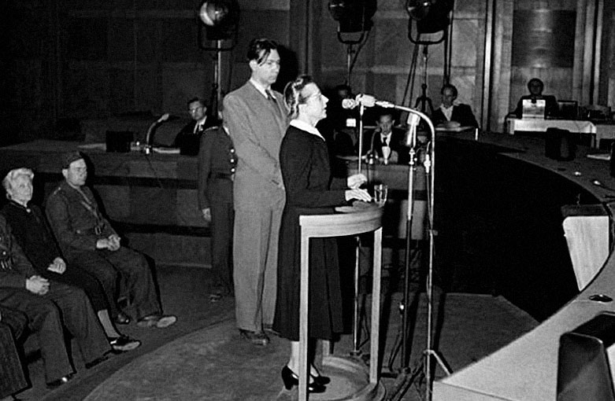
The ECCB under Totalitarian Regimes
During WWII the ECCB operates
in occupied territory called
the Protectorate of Bohemia and Moravia
Secret education of students of theology
Some ECCB members took part in National
and foreign anti-Nazi resistance
Under communist oppression the ECCB
found itself caught between acceptance
or even legitimation of the regime and protest
against violations of human rights
Pastors and Church members were jailed
or got restrictions
Two ECCB members have become symbols
of resistence against communist regime:
Milada Horáková as one of the victims
of manipulated political processes and Jan
Palach – a young student who set himself
afire in 1969

Slide 6
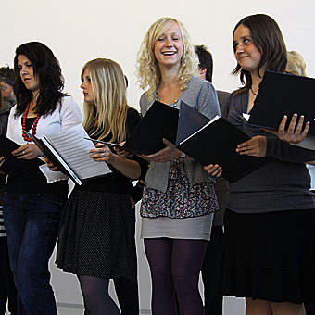
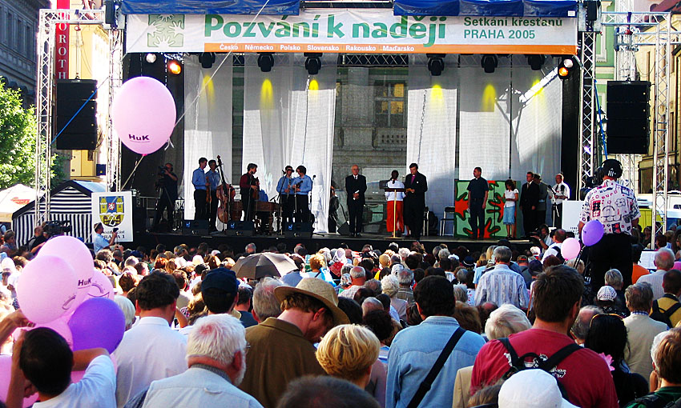
After the Velvet Revolution
In 1989 the ECCB actively joined
public changes
Activities of Diaconia were reestablished
New opportunities in work with children
and youth
New challenges and tasks, which belong
to life in free democratic society

Slide 7
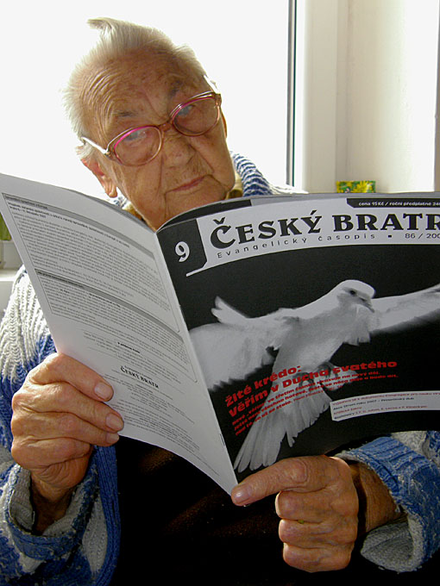
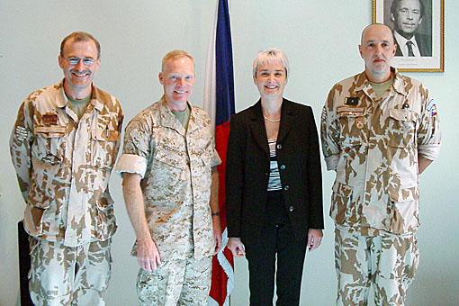
Public service
Chaplaincy service
At the moment there are 32 military
chaplains from 8 Christian Churches.
Eight of them are from the ECCB
There are 37 chaplains in prison pastoral
care from 10 Churches. Eight of them
are from the ECCB
In 2011 the Association of Health Care
Chaplaincy was established. At the present
time there are 7 chaplains from the ECCB
Media
Who we are, what we believe and what
we do is presented by at www.e-cirkev.cz
The Protestant magazine Český bratr,
2,900 copies, www.ceskybratr.cz
The Youth magazine Nota nebe,
750 copies, http://notanebe.cz/

Slide 8
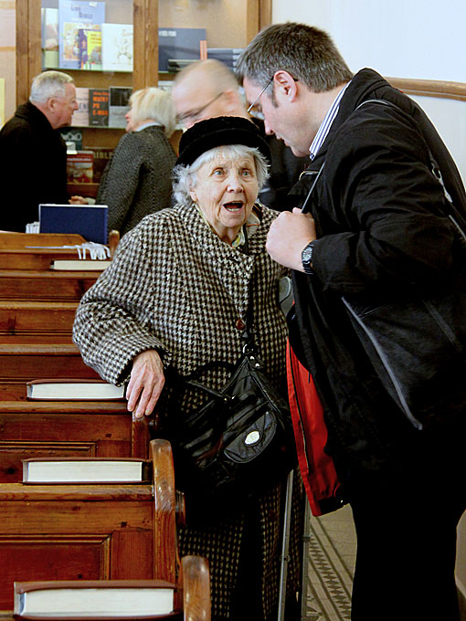
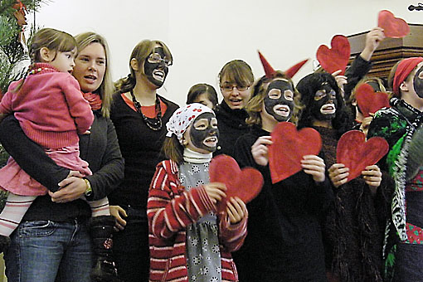
Life in our Congregations
Worship
Educational programs for children,
youth and seniors
Care for the sick
Various cultural and sport activities:
music and film festivals, balls or poetry
evenings
Local and international charity programs

Slide 9
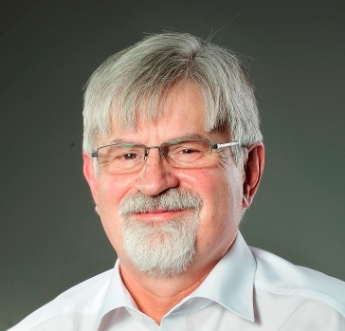
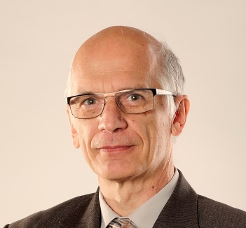
Organizational Structure
of the ECCB
Synodal Senior
Rev. Daniel Ženatý
Synodal Curator
Vladimír Zikmund
^{Church} | Synodal Senior (Moderator) Synodal Curator (Lay Moderator) ^{6 years} | ^{Synodal Council} ^{3 clergy + 3 lay people} ^{6 years} | ^{SYNOD} ^{76 delegates} ^{4 years}
^{Seniorat Presbytery} | ^{Presbytery Senior} ^{Presbytery Curator} ^{6 years} | ^{Presbytery Council} ^{6 years} | ^{Convent} ^{4 years}
^{Congregation} | ^{Pastor + Curator (Lay leader)} | ^{Elders} | ^{Annual Congregational meeting}

Slide 10
The ECCB in numbers
251 local congregations
216 pastors
14 presbyteries
72,297 members according the church rolls
Other ECCB congregations in Ukraine,
Poland, Romania, Serbia and Croatia

Slide 11
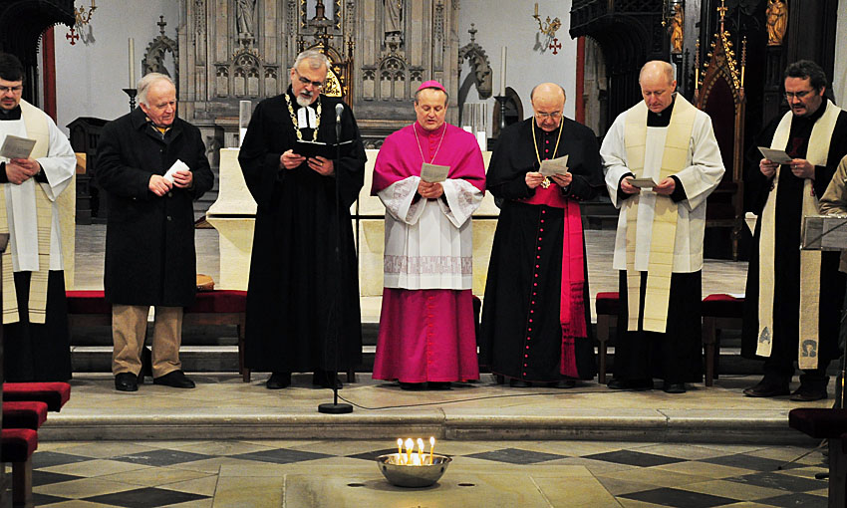
Ecumenical and International
Relations
Ecumenically open fellowship
Four confessions: the Augsburg of 1530,
the Brethen of 1535, the Second Helvetic
of 1566 and the Czech Confession of 1575
Member of the World Council of Churches,
the Conference of European Churches
and the Community of Protestant Churches
in Europe, the World Communion
of Reformed Churches and the Lutheran
World Federation
The ECCB is a member of the Ecumenical
Council in the Czech Republic and of
the Leuenberg Synod in the Czech Republic
Cooperation with the Roman Catholic
and the Old Catholic Church and others
Interfaith dialogue with Jews, Muslims
and other religions

Slide 12
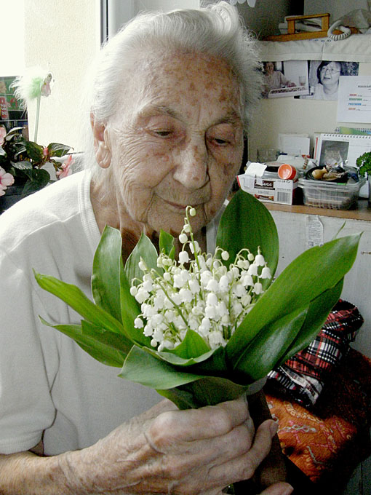
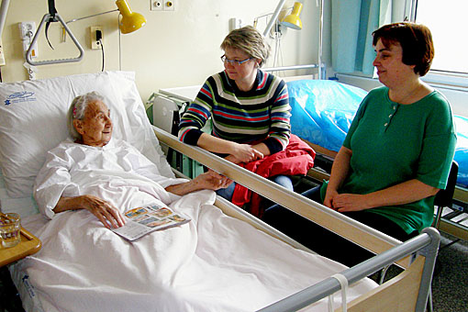
Diaconia of the ECCB
Help Has Many Faces
Christian non-profit organization,
who´s founder is the ECCB
One of the largest organizations
of this kind in the Czech Republic
Offers social, medical, educational
and pastoral care in 27 centres
and 8 special schools
Open to everyone regardless of religious,
ethnic and political affiliation or sexual
orientation

Slide 13
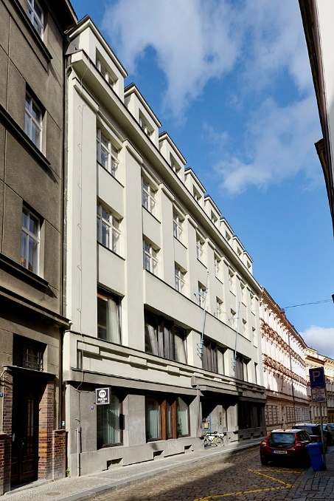
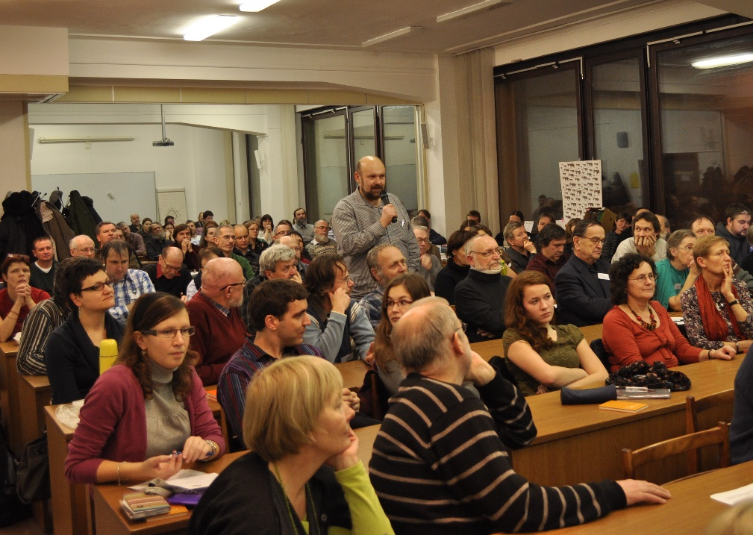
The Protestant Theological Faculty
The PTF is the successor of the Hus
Theological Faculty (1919 – 1949)
and the Comenius Protestant Theological
Faculty (1949 – 1990)
Studies at PTF are required for ordination
in the ECCB
620 students in bachelor, master´s
and PhD programs and at the lifelong
learning programs
Academic work of processors is focused
on Church history, hermeneutics
and Biblical studies
Centre for Biblical Studies

